Slide 1


Math 6380O Project 1
Feature Extraction and Transfer Learning
Chunyan BAI, Haoye CAI, Yuan CHEN, Wenshuo GUO
Department of Computer Science and Engineering
Hong Kong University of Science and Technology

Slide 2
Introduction
A warm-up aims to explore feature extractions using existing networks
The existing networks used in the project include: pre-trained deep neural networks and scattering nets
Image classifications with traditional machine learning methods

Slide 3
Introduction
2 datasets to perform classification task - Raphael's dataset and MNIST's dataset
2 pre-trained deep neural networks and scattering nets
6 visualization approaches: PCA, MDS and t-SNE etc. to visualize the extracted features
4 traditional supervised learning methods implemented based on the extracted features, including LDA, logistic regression, SVM, random forests to classify images
Notes:
Now we will present the experiment results and give in-depth analysis on why such results are formed, and what they reveal about the feature extraction framework.

Slide 4
Related Work: Scattering Network
We hereby adopt the improved version of scattering network as proposed by Oyallon et al [1].
This invariant scattering network utilized two wavelet transformation to build a non-trivial invariant and retain both high-frequency and low-frequency domain.

Slide 5
Related Work: Scattering Network
To deal with images, we apply scattering transformation on each RGB channel of the image, resulting in a final channel of 3×(1+JL+12J(J−1)L2)3×(1+JL+12J(J−1)L2), and the image is downsampled by a factor of 2^J, where J is the spatial scale of scattering transform and L is an integer parametrizing a discretization of [0,2π].
We use scattering network to explore its efficiency compared with modern data-driven neural networks.

Slide 6
Related Work: VGG19 and ResNet50
Both VGG [3] and ResNet [4] are convolutional neural networks designed to perform image recognition. Their success on ImageNet [5] dataset has proven their efficacy in extracting meaningful feature from general images.
Therefore we choose VGG19 and ResNet50 pre-trained on ImageNet as the base neural network for feature extraction in this project.

Slide 7
Related Work: VGG19 and ResNet50
These two networks also make good comparisons against each other
VGG19 is considered shallow but may preserve more details in its feature map, while ResNet50 is much deeper and the final feature consists of high-level visual cues.

Slide 8
Dataset 1: Raphael’s paintings identification
A small dataset of Raphael's/forgeries paintings. There are 28 images in total.
The idea of whether extracted feature works on such a small dataset would further illustrates the difference/connection of various methodologies. There has been previous study on authenticating Van Gogh paintings by Liu et al [2].
We resize all the images to 224*224, and use transfer learning to train classifiers to identify forgeries. We use leave-one-out validation as the dataset is of limited size.

Slide 9
Dataset 2: MNIST
MNIST is a simple yet effective dataset to explore the learnt feature of networks, given it is made up of numerous handwritten digits.
It consists of 60000 gray-scale training images of size 2828 and 10 classes.
In our experiment we resize all the images to 224224, and choose only a subset of the train/test images due to time concern.

Slide 10
Result: Dataset 1 Raphael’s Painting

Slide 11
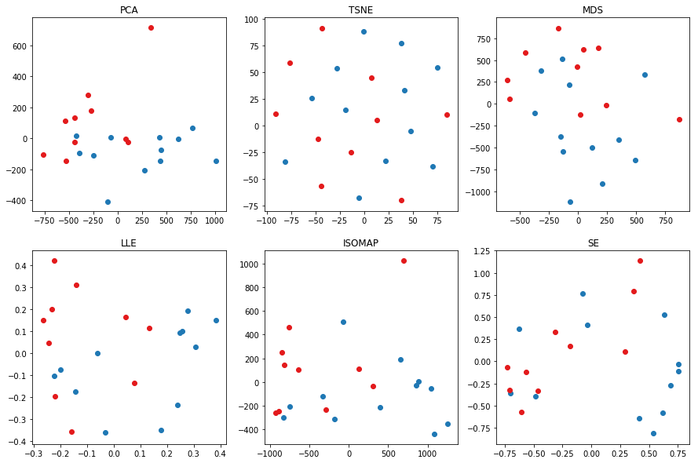
Results: Visualization of Scattering Network

Slide 12
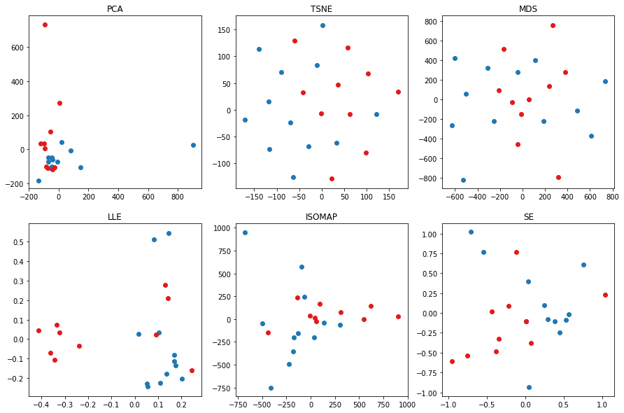
Results: Visualization of VGG19 Network

Slide 13
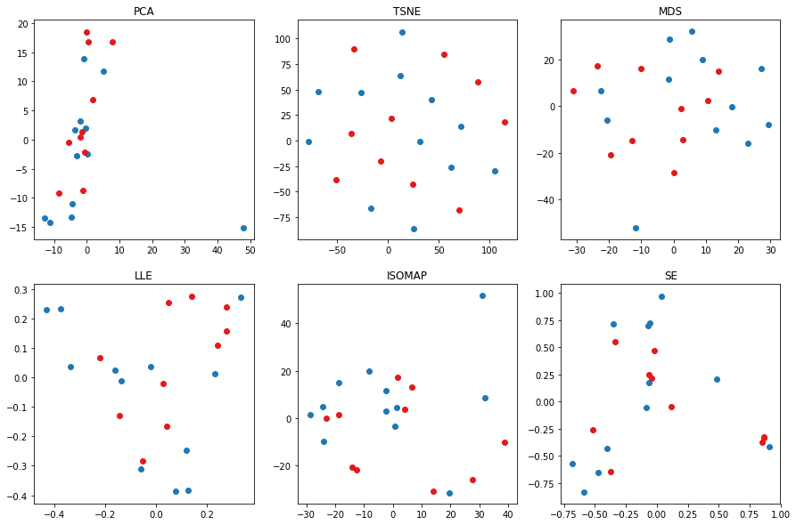
Results: Visualization of ResNet50 Network

Slide 14
Visualization Summary: Raphael Dataset Result
Deep Learning Networks Comparison through the Same Visualisation
The scattering network tends to separate the features into two parts.
VGG19 tends to project most features in a relative small space
ResNet50 tends to preserve more linear structures
Three networks perform differently in feature extraction, which may due to their different architectures.

Slide 15
Visualization Summary: Raphael Dataset Result
Different Visualisation Approaches through the Same Network
PCA is a linear transformation of the dimensions, and often miss important non-linear structure in the data.
t-SNE seems to have the best performance among all six methods. The clusters are obvious than those in other figures and the points are projected almost uniformly in the space.
Notes:
Different visualisation methods fit in different models.

Slide 16
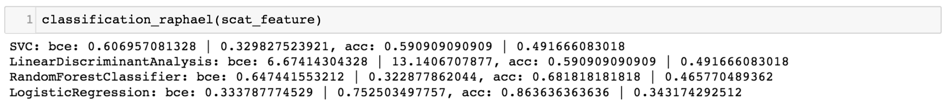
Results: Scattering Net - Classification on the extracted features
Classification evaluation function: Outputs are cross entropy (negative log likelihood) and accuracy. The number before and after the '|' is the mean and the standard deviation respectively.

Slide 17
Results: Scattering Net - Classification on the extracted features
For the features extracted by the Scattering Network, Logistic Regression has the lowest cross entropy loss and the highest accuracy, which indicates the best classification performance.
When taking standard deviation into consideration, however, since all the standard deviations are relatively large, especially compared to the means, we find that all methods are actually similar (at least similarly unstable). This is understandable because as we can see in the visualizations, the extracted features cannot be easily linearly separated, and positive and negative features tend to mix together.
Notes:
This is understandable because as we can see in the visualizations, the extracted features cannot be easily linearly separated, and positive and negative features tend to mix together.

Slide 18
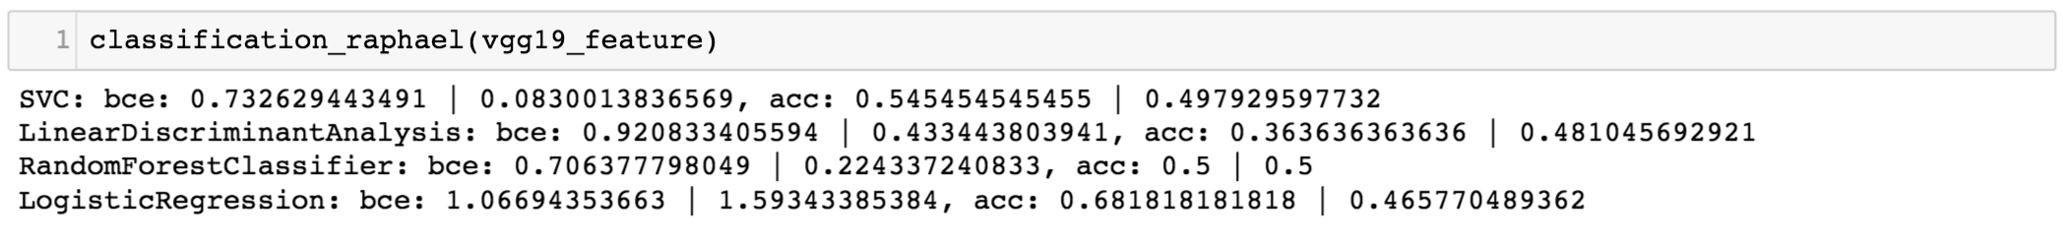
Results: VGG19 - Classification on the extracted features
Classification evaluation function: Outputs are cross entropy (negative log likelihood) and accuracy. The number before and after the '|' is the mean and the standard deviation respectively.

Slide 19
Results: VGG19 - Classification on the extracted features
For the features extracted by the VGG19 Network, Logistic Regression still has the highest accuracy but Random Forest and SVM show the lowest cross entropy loss.
Therefore we conclude for these features, the three classifiers mentioned indicate reasonably good performance. The bad performance shown by LDA may indicate this feature distribution violates the LDA gaussian assumptions.

Slide 20
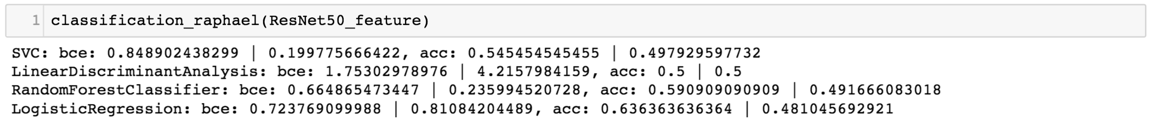
Results: ResNet50 - Classification on the extracted features
Classification evaluation function: Outputs are cross entropy (negative log likelihood) and accuracy. The number before and after the '|' is the mean and the standard deviation respectively.

Slide 21
Results: ResNet50 - Classification on the extracted features
From the statistics, for the features extracted by the ResNet50 Network, Logistic Regression still has the highest accuracy but the difference seems to further shrink, i.e. four methods have similar accuracy and cross entropy (except for LDA which has larger cross entropy).
The bad/unstable output distribution shown by LDA may indicate this feature distribution violates the LDA gaussian assumptions. But more importantly, as shown in the visualization, the features from different classes seem to further mix together, making classifiers more difficult to distinguish. This may explain the not-so-good results shown by all methods.

Slide 22
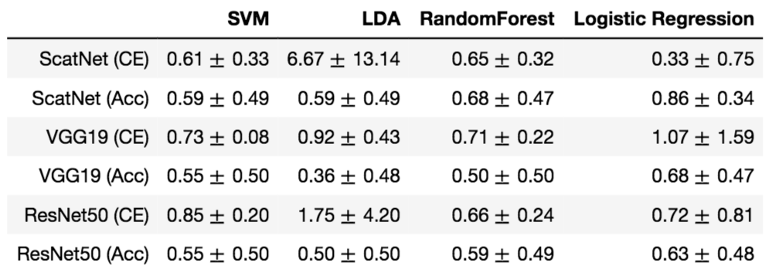
Classification Summary: Raphael Dataset Result

Slide 23
Classification Summary: Raphael Dataset Result
Logistic Regression achieve best accuracy/log loss for all types of features; LDA almost always perform the worst
The first implication: this Raphael Drawing dataset has a data distribution that is very different from the LDA gaussian assumption. This may serve as the main reason for the bad performance.
The next important observation: the simplest method seems to be more suitable for this dataset. More complicated methods like SVM have high potential to overfit, and simpler methods have better chance to make good decisions in the test set.

Slide 24
Which features are more robust or more suitable for this dataset?
As shown by the numbers, no matter for the best or the average performance by the classifiers, Scattering Network seems to provide more reasonable features.
This may be explained by the ability inherent in the wavelet operations to process/find fixed patterns, which may enforce its analysis on the textures of drawings, thus leading to easier thresholds between classes.

Slide 25
Which features are more robust or more suitable for this dataset?
For the two deep nets, since they are trained on large scale datasets, they are more likely to find universal patterns which may not be helpful for this specific task.
In addition, since ResNet50 has much more layers than VGG19 (increased depth), it may provide much more complicated and high-level features in deeper layers.
This may be the reason why ResNet features seem to be more mixed.

Slide 26
Result: Dataset 2 MNIST

Slide 27
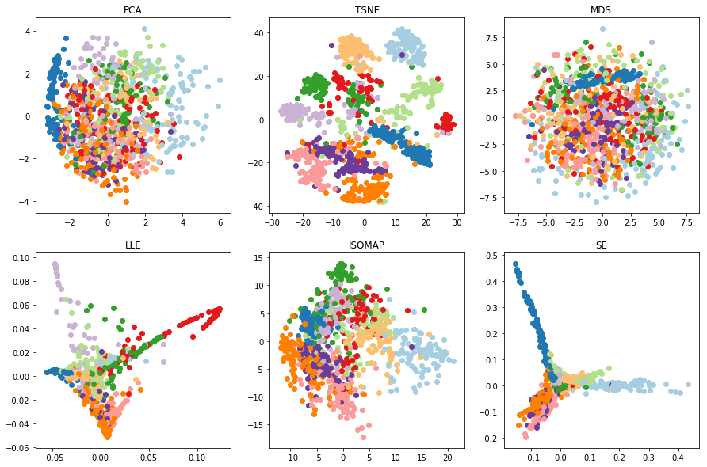

Results: Visualization of Scattering Network
0
1
2
3
4
5
6
7
8
9

Slide 28
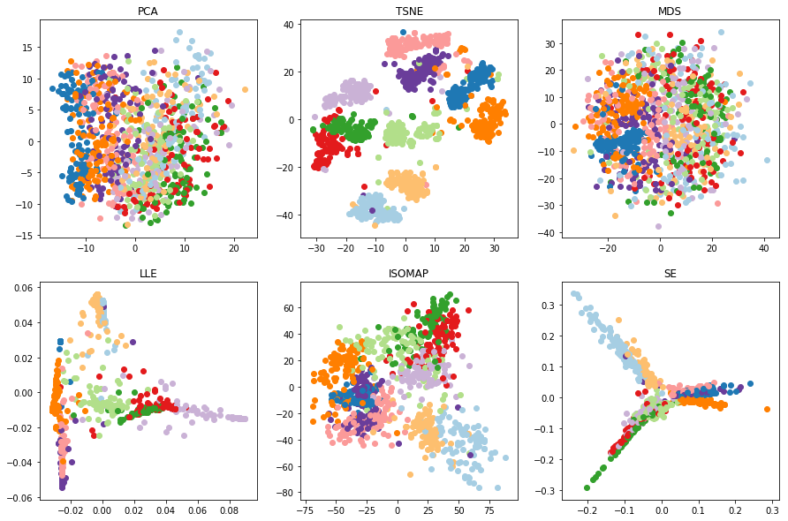
Results: Visualization of VGG19 Network
0
1
2
3
4
5
6
7
8
9

Slide 29
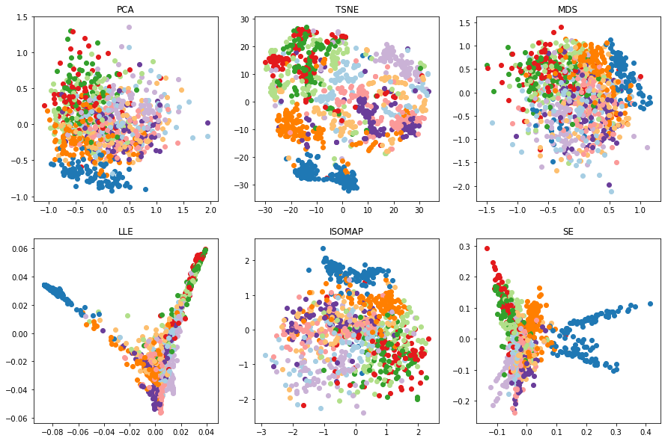
Results: Visualization of ResNet50 Network
0
1
2
3
4
5
6
7
8
9

Slide 30
Visualization Summary: MNIST
Deep Learning Networks Comparison through the Same Visualisation
The features extracted by Scattering Network and VGG19 and dimensionally reduced by these visualisation approaches are presented better than those of ResNet50.

Slide 31
Visualization Summary: MNIST
Different Visualisation Approaches through the Same Network
Non-linear structure in the data is very significant since PCA which tries to find the linear transformation among dimensions and MDS which measures the distance similarity between objects seem to mix clusters, which means some features may look very similar even though they are from different groups in the dataset.
Notes:
Different visualisation methods fit in different models.

Slide 32
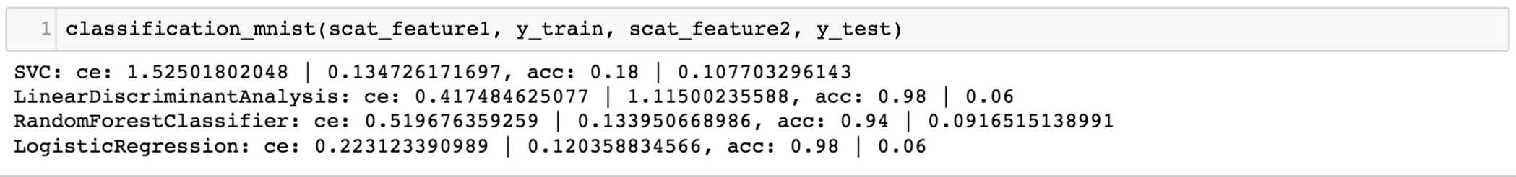
Results: Scattering Net - Classification on the extracted features
Classification evaluation function: Outputs are cross entropy (negative log likelihood) and accuracy. The number before and after the '|' is the mean and the standard deviation respectively.

Slide 33
Results: Scattering Net - Classification on the extracted features
For the features extracted from MNIST by the Scattering Network, Logistic Regression still has the lowest cross entropy loss and the highest accuracy, which indicates the best classification performance.
Linear Discriminant Analysis also has similar level of performance while non-linear classifier like SVM and Random Forest performed suboptimally, we can see that a linear decision boundary is already sufficient for MNIST features. When taking standard deviation into consideration, 3 out of 4 has low std, indicating its highly linearity, which is consistent with the visualization.

Slide 34
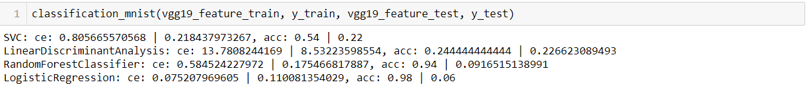
Results: VGG19 - Classification on the extracted features
Classification evaluation function: Outputs are cross entropy (negative log likelihood) and accuracy. The number before and after the '|' is the mean and the standard deviation respectively.

Slide 35
Results: VGG19 - Classification on the extracted features
For the features extracted from MNIST by VGG19, Logistic Regression still has the lowest cross entropy loss and the highest accuracy, which indicates the best classification performance.
Random Forest also has similar level of performance while other classifier like SVM and LDA performed suboptimally. We can see that the feature from VGG-19 is of high semantic meaning. When taking standard deviation into consideration, 2 out of 4 has low std, indicating its certain non-linearity, which is consistent with the visualization.

Slide 36
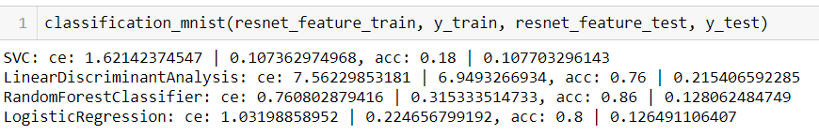
Results: ResNet50 - Classification on the extracted features
Classification evaluation function: Outputs are cross entropy (negative log likelihood) and accuracy. The number before and after the '|' is the mean and the standard deviation respectively.

Slide 37
Results: ResNet50 - Classification on the extracted features
For the features extracted from MNIST by ResNet50, Random Forest has the lowest cross entropy loss and the highest accuracy, which indicates the best classification performance.
Logistic Regression and LDA also has similar level of performance while other classifier like SVM performed suboptimally. We can see that the feature from ResNet50 is of relatively low semantic meaning, resulting in lower accuracy overall. It is possibly due to the deep network structure where most information are thrown away. When taking standard deviation into consideration, most of them are quite high, indicating its not quite linear, which is consistent with the visualization and analysis.

Slide 38
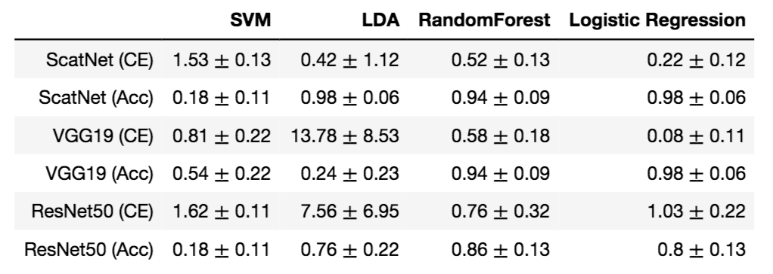
Classification Summary: MNIST

Slide 39
Classification Summary: MNIST
Logistic Regression and Random Forest are the best among all results.
Smaller standard deviation (i.e. variance) compared with the Raphael's Drawing dataset
By analyzing performance gaps of certain algorithms, we may learn some characteristics about our learned feature distributions. For example, the low accuracy of LDA on VGG19 features may indicate the feature of VGG19 is not combination of gaussian distribution with equal variance.

Slide 40
Distribution of Work
Chunyan BAI: Feature extraction by scattering net with known invariants;
Wenshuo GUO: Feature extraction by pre-trained deep neural networks, e.g. VGG19, and resnet50;
Yuan CHEN: Visualize these features using classical unsupervised learning methods, e.g. PCA, t-SNE, MDS, LLE, isomap, Spectral Embedding (SE);
Haoye CAI: Image classifications using traditional supervised learning methods based on the features extracted, e.g. LDA, logistic regression, SVM, random forests;
All members equally: Report writing. Compare the results obtained and give analysis on explaining the phenomena.

Slide 41
Reference
Oyallon, E., Belilovsky, E., & Zagoruyko, S. (2017, October). Scaling the scattering transform: Deep hybrid networks. In International Conference on Computer Vision (ICCV).
Liu, H., Chan, R. H., & Yao, Y. (2016). Geometric tight frame based stylometry for art authentication of van Gogh paintings. Applied And Computational Harmonic Analysis, 41(2), 590-602.
Simonyan, K., & Zisserman, A. (2014). Very deep convolutional networks for large-scale image recognition. arXiv preprint arXiv:1409.1556.
He, K., Zhang, X., Ren, S., & Sun, J. (2016). Deep residual learning for image recognition. In Proceedings of the IEEE conference on computer vision and pattern recognition (pp. 770-778).
Deng, J., Dong, W., Socher, R., Li, L. J., Li, K., & Fei-Fei, L. (2009, June). Imagenet: A large-scale hierarchical image database. In Computer Vision and Pattern Recognition, 2009. CVPR 2009. IEEE Conference on (pp. 248-255). IEEE.

Slide 42
Thank You!
Q&A

